Slide 1
Kinect Player Gender Recognition from Speech Analysis
Radford Parker
ECE 6254

Slide 2
Problem
Currently, the Kinect can recognize gender of players through image processing techniques
Can a system be designed that in real-time, recognizes gender by using only speech analysis?
This would improve the computational efficiency of the system drastically as it moves from two-dimensional analysis to one-dimensional analysis

Slide 3
Background
There have been many implementations with a large variety of features proposed
Some examples include pitch [1], harmonic structure [2], cepstral analysis [3], and spectral coefficients [4]
Only recently has work been done on real-time streaming audio gender recognition [5]

Slide 4
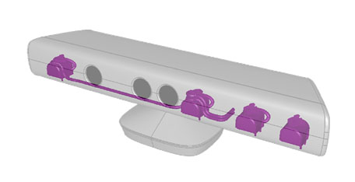
Hardware
The Microsoft Kinect contains an RGB camera, calibrated IR-based depth sensor, and a four microphone array
It records four separate channels at 16 kHz

Slide 5
Getting the Spectrum
In order to achieve real-time performance, a simple approach was taken using an FFT based on the Danielson and Lanczos algorithm
The algorithm would detect when a player is speaking and then would take the FFT of an overlapping Hamming window

Slide 6
Finding the Peaks
Once the spectrum has been found, the peak of the signal, f_{p,} is detected between 75 Hz and 275 Hz
This is the typical vocal range for adult humans [6]
Because f_{p} can be a harmonic, smaller peaks are checked for at f_{p}/2 and f_{p}/3

Slide 7
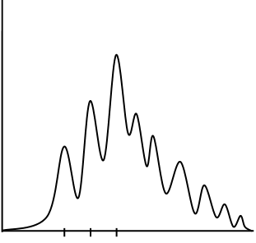
Finding the Pitch
The neighborhoods around f_{p}/2 and f_{p}/3 are searched
The actual pitch, f_{a}, is found when all frequencies in the local area have a smaller response and the gain is significant compared to the entire spectrum

Slide 8
Determining Gender
The algorithm is run every 8192 samples (about 500 ms), with an overlap of 1024 samples
If the max volume of those samples is significant enough to be speech, the FFT is computed
For every FFT, an associated f_{a} is found and classified as male if in (70, 140) and female if in (165, 275)
These scores are aggregated and whenever one gender outnumbers the other by a certain factor, the player is designated that gender
This aggregation can allow for greater confidence

Slide 9
Experimentation
In order to verify the algorithm, tests were performed offline using the same approach
The samples were taken from the TSP Speech Database and are all a few seconds in length and sampled at 48 kHz
The dataset contains 1,444 speech samples spoken by 14 different females and 11 different males

Slide 10
Data Set Results
Contingency table for the TSP data set:
Which, when removing unknowns, yields a correct classification of 92% of males and 96% of females
 | Actual Males | Actual Females
Predicted Males | 549 | 28
Predicted Females | 51 | 704
Unknown | 60 | 52

Slide 11
Timing Results
For the TSP data set, the algorithm runs on average around 15 ms per every second of recording, or every 48,000 samples
Even with the additional Kinect overhead of streaming video, streaming depth, performing skeletal tracking, and recording all four channels, the algorithm can still run in real-time

Slide 12
Kinect Male Player Result

Slide 13
Kinect Female Player Result

Slide 14
Kinect Two Player Result

Slide 15
References
[1] Parris, E. S., Carey, M. J., Language Dependent Gender Identification. Acoustics, Speech, and Signal Processing. ICASSP-96 Conference Proceedings, vol. 2. (1996) 685 - 688.
[2] Vergin, R., Farhat A., O'Shaughnessy D.: Robust Gender-dependent Acoustic-phonetic Modelling in Continuous Speech Recognition Based on a New Automatic Male/female Classification. ICSLP-96 Conference Proceedings, vol. 2. October (1996) 1081-1084.
[3] Hurb, H., Chen, L., Gender Identification Using a General Audio Classifier. ICME '03 Proceedings, vol. 2. July (2003) 733-736.
[4] Slomka, S., Sridharan, S., Automatic Gender Identification Optimised for Language Independence. TENCON '97 IEEE Region 10 Annual Conference. Speech and Image Technologies for Computing and Telecommunications Conference Proceedings, vol. 1. December (1997) 685 - 688.
[5] E. Scheme, E. Castillo-Guerra, K. Englehart, and A. Kizhanatham, “Practical considerations for real-time implementation of speech-based gender detection,” in Proc. of the Iberoamerican Cong. in Patt. Reco., Nov 2006.
[6] Baken, R. J. Clinical Measurement of Speech and Voice. London: Taylor and Francis Ltd. (1987).

